Slide 1
Chapter 4
Multiple Regression Analysis
(Part 1)
Terry Dielman
Applied Regression Analysis:
A Second Course in Business and Economic Statistics, fourth edition
Multiple Regression I
Copyright © 2005 Brooks/Cole, a division of Thomson Learning, Inc.

Slide 2
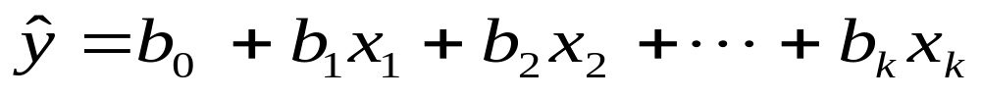
4.1 Using Multiple Regression
In Chapter 3, the method of least squares was used to describe the relationship between a dependent variable y and an explanatory variable x.
Here we extend that to two or more predictor variables, using an equation of the form:
Multiple Regression I
Copyright © 2005 Brooks/Cole, a division of Thomson Learning, Inc.

Slide 3
Basic Exploration
In Chapter 3 our main graphic tool was the X-Y scatter plot.
Exploratory graphics are a bit harder to produce here because they need to be multidimensional.
Even if there were just two x variables a 3-D display is needed.
Multiple Regression I
Copyright © 2005 Brooks/Cole, a division of Thomson Learning, Inc.

Slide 4
Estimation of Coefficients
We want an equation of the form:
As before we use least squares. The coefficients b₀ b₁ b₂ ... b_{k} are determined by minimizing the sum of squared residuals.
Multiple Regression I
Copyright © 2005 Brooks/Cole, a division of Thomson Learning, Inc.

Slide 5
Formulae are Very Complex
Can show exact formula when k=1 (simple regression). Refer to Section 3.1.
Few texts show the formulae for k=2 (the simplest of multiple regressions)
Appendix D shows formula in matrix notation
This is totally a computer problem
Multiple Regression I
Copyright © 2005 Brooks/Cole, a division of Thomson Learning, Inc.
Notes:
Multiple Regression I

Slide 6
Example 4.1 Meddicorp Sales
n = 25 sales territories
Y = Sales (1000$) in each territory
X₁ = Advertising (100$) in territory
X₂ = Amount of bonuses (100$) paid
to salespersons in the territory
Data set MEDDICORP4
Multiple Regression I
Copyright © 2005 Brooks/Cole, a division of Thomson Learning, Inc.

Slide 7
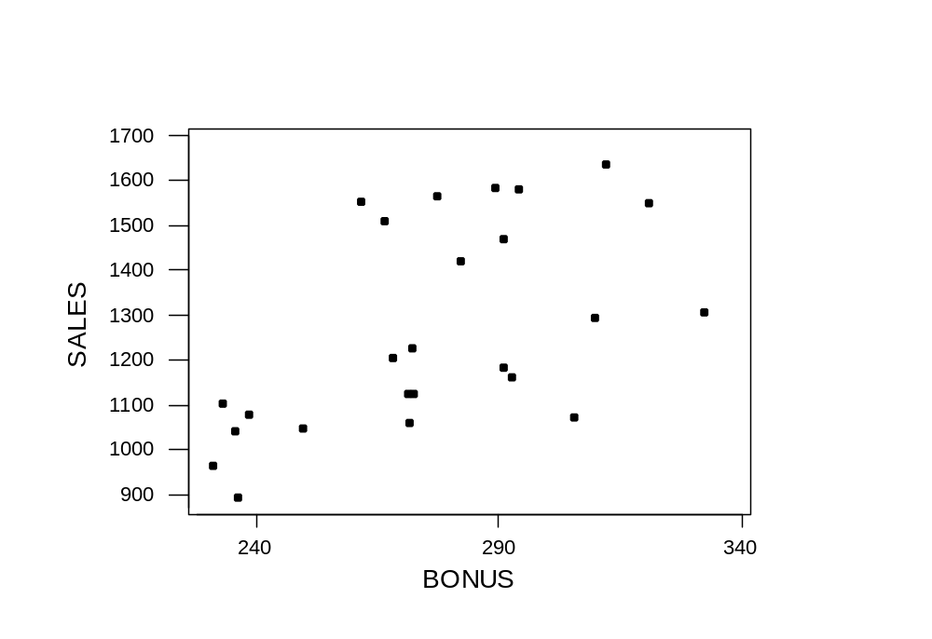
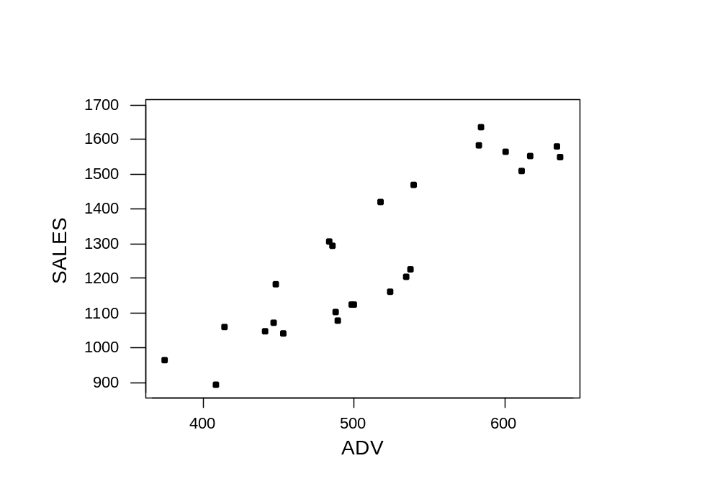
Plots and Correlation
Correlations
SALES ADV
ADV 0.900
BONUS 0.568 0.419
Multiple Regression I
Copyright © 2005 Brooks/Cole, a division of Thomson Learning, Inc.

Slide 8
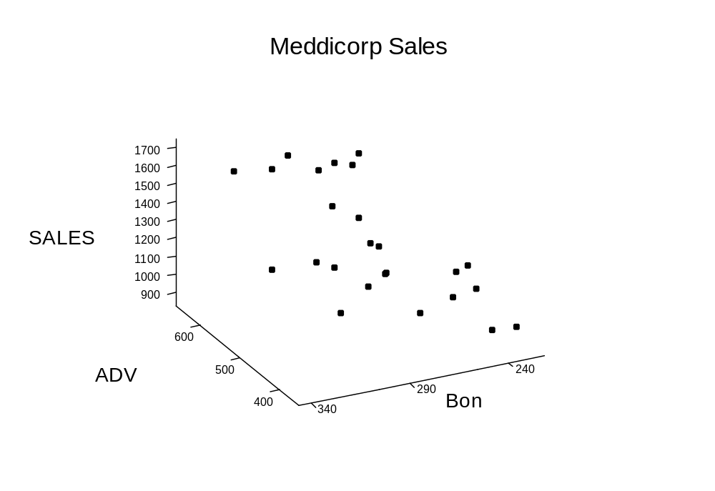
3D Graphics
Multiple Regression I
Copyright © 2005 Brooks/Cole, a division of Thomson Learning, Inc.

Slide 9
Minitab Regression Output
The regression equation is
SALES = - 516 + 2.47 ADV + 1.86 BONUS
Predictor Coef SE Coef T P
Constant -516.4 189.9 -2.72 0.013
ADV 2.4732 0.2753 8.98 0.000
BONUS 1.8562 0.7157 2.59 0.017
S = 90.75 R-Sq = 85.5% R-Sq(adj) = 84.2%
Analysis of Variance
Source DF SS MS F P
Regression 2 1067797 533899 64.83 0.000
Residual Error 22 181176 8235
Total 24 1248974
Multiple Regression I
Copyright © 2005 Brooks/Cole, a division of Thomson Learning, Inc.

Slide 10
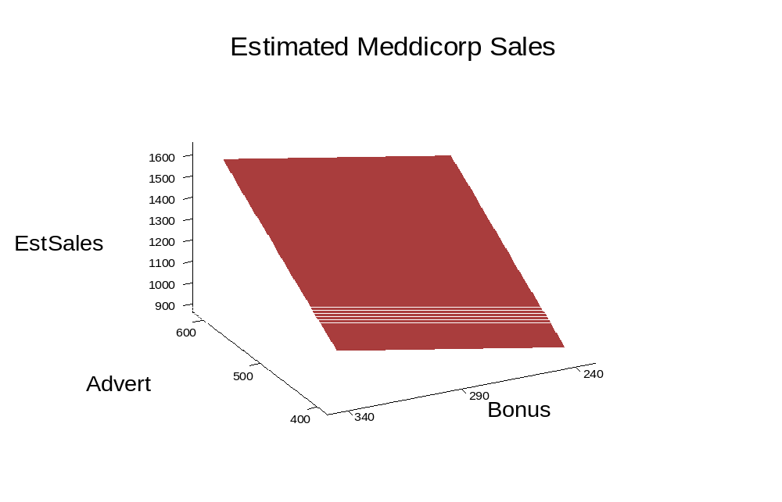
3D Surface Graph
The regression equation is
SALES = - 516 + 2.47 ADV + 1.86 BONUS
Multiple Regression I
Copyright © 2005 Brooks/Cole, a division of Thomson Learning, Inc.

Slide 11
Interpretation of Coefficients
The regression equation is
SALES = - 516 + 2.47 ADV + 1.86 BONUS
Recall that sales is in $1000s and advertising and bonus in $100s.
If advertising is held fixed, sales increase $1860 for each $100 of bonus paid.
If bonus were fixed, sales increase $2470 for each $100 spent on ads.
Multiple Regression I
Copyright © 2005 Brooks/Cole, a division of Thomson Learning, Inc.

Slide 12
4.2 Inferences From a Multiple
Regression Analysis
In general, the population regression equation involving K predictors is:
This says the mean value of y at a given set of x values is a point on the surface described by the terms on the right-hand side of the equation.
Multiple Regression I
Copyright © 2005 Brooks/Cole, a division of Thomson Learning, Inc.

Slide 13
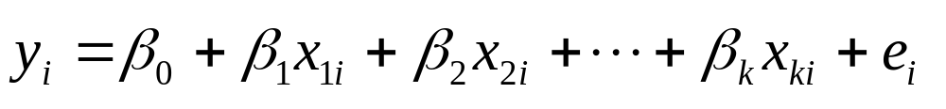
4.2.1 Assumptions Concerning the Population Regression Line
An alternative way of writing the relationship is:
where i denotes the i^{th} observation and e_{i} denotes a random error or disturbance (deviation from the mean).
We make certain assumptions about the e_{i}.
Multiple Regression I
Copyright © 2005 Brooks/Cole, a division of Thomson Learning, Inc.

Slide 14
Assumptions
We expect the average disturbance e_{i} to be zero so the regression line passes through the average value of y.
The e_{i} have constant variance σ_{e}².
The e_{i} are normally distributed.
The e_{i} are independent.
Multiple Regression I
Copyright © 2005 Brooks/Cole, a division of Thomson Learning, Inc.

Slide 15
Inferences
The assumptions allow inferences about the population relationship to be made from a sample equation.
The first inferences considered are those about the individual population coefficients β₁ β₂ ... β_{K}.
Chapter 6 examines what happens when the assumptions are violated.
Multiple Regression I
Copyright © 2005 Brooks/Cole, a division of Thomson Learning, Inc.

Slide 16
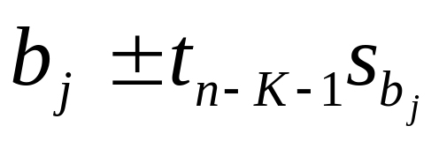
4.2.2 Inferences about the Population Regression Coefficients
If we wish to make an estimate of the effect of a change in one of the x variables on y, use the interval:
this refers to the j^{th} of the K regression coefficients. The multiplier t is selected from the t-distribution with n-K-1 degrees of freedom.
Multiple Regression I
Copyright © 2005 Brooks/Cole, a division of Thomson Learning, Inc.

Slide 17
Tests About the Coefficients
A test about the marginal effect of x_{j} on y may be obtained from:
H₀: β_{j} = β_{j}*
H_{a}: β_{j} ≠ β_{j}*
where β_{j}* is some specific value that is relevant for the j^{th} coefficient.
Multiple Regression I
Copyright © 2005 Brooks/Cole, a division of Thomson Learning, Inc.

Slide 18
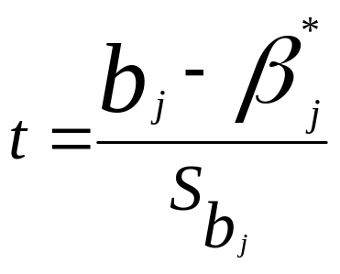
Test Statistic
The test would be performed by using the standardized test statistic:
The most common form of this test is for the parameter to be 0. In this case the test statistic is just the estimate divided by its standard error.
Multiple Regression I
Copyright © 2005 Brooks/Cole, a division of Thomson Learning, Inc.

Slide 19
Example 4.2 Meddicorp (Continued)
Refer again to the portion of the regression output about the individual regression coefficients:
This lists the estimates, their standard errors and the ratio of the estimates to their standard errors.
Predictor Coef SE Coef T P
Constant -516.4 189.9 -2.72 0.013
ADV 2.4732 0.2753 8.98 0.000
BONUS 1.8562 0.7157 2.59 0.017
Multiple Regression I
Copyright © 2005 Brooks/Cole, a division of Thomson Learning, Inc.

Slide 20
Tests For Effect of Advertising
To see if an increase in advertising expenditure affects sales, we can test:
H₀: β_{ADV} = 0 (An increase in advertising
has no effect on sales)
H_{a}: β_{ADV} ≠ 0 (Sales do change when
advertising increases)
The df are n-K-1 = 25–2-1 = 22. At a 5% significance level, the critical point from the t-table is 2.074
Multiple Regression I
Copyright © 2005 Brooks/Cole, a division of Thomson Learning, Inc.

Slide 21
Test Result
From the output we get:
t = ( 2.4732 – 0)/.2753 = 8.98
This is above the critical value of 2.074, so we reject H₀.
Note that we could also make use of the p-value (.000) for the test.
Multiple Regression I
Copyright © 2005 Brooks/Cole, a division of Thomson Learning, Inc.

Slide 22
One-Sided Test on Bonus
We can modify the test to make it one sided
H₀: β_{BONUS} = 0 (Increased bonuses
do not affect sales)
H_{a}: β_{BONUS} > 0 (Sales increase when
bonuses are higher)
At a 5% significance level, the (one-sided) critical point is 1.717.
Multiple Regression I
Copyright © 2005 Brooks/Cole, a division of Thomson Learning, Inc.

Slide 23
One-Sided Test Result
From the output we get:
t = 1.8562/.7157 = 2.59 which is > 1.717
We reject H₀ but this time make a more specific conclusion.
The listed p-value (.017) is for a two-sided test. For our one-sided test, cut it in half.
Multiple Regression I
Copyright © 2005 Brooks/Cole, a division of Thomson Learning, Inc.

Slide 24
Interval Effect of advertising
Recall that sales are measured in 1000$ and ADV in 100$
b_{adv} = 2.4732 and has standard error = .2753
2.4732 ± 2.074(.2753) = 2.4732 ± .5709
= 1.902 to 3.044
Each $100 spent on advertising returns $1902 to $3044 in sales.
Multiple Regression I
Copyright © 2005 Brooks/Cole, a division of Thomson Learning, Inc.

Slide 25
4.3 Assessing the Fit of the Model
Recall how we partitioned the variation in the previous chapter:
SST = Total variation in the sample of Y values
Split up into two components SSE, SSR
SSE = Error or unexplained variation
SSR = Explained by the Yhat function
Multiple Regression I
Copyright © 2005 Brooks/Cole, a division of Thomson Learning, Inc.

Slide 26
4.3.1 The ANOVA Table and R²
These are the same statistics we briefly examined in simple regression.
They are perhaps more important here because they measure how well all the variables in the equation work together.
S = 90.75 R-Sq = 85.5% R-Sq(adj) = 84.2%
Analysis of Variance
Source DF SS MS F P
Regression 2 1067797 533899 64.83 0.000
Residual Error 22 181176 8235
Total 24 1248974
Multiple Regression I
Copyright © 2005 Brooks/Cole, a division of Thomson Learning, Inc.

Slide 27
R² – a Universal Measure of Fit
R² = SSR / SST = proportion of variation explained by the regression equation.
If multiplied by 100, interpret as %
If only one x, R² is square of correlation
For multiple, R² is square of correlation between the Y values and Y-hat values
Multiple Regression I
Copyright © 2005 Brooks/Cole, a division of Thomson Learning, Inc.

Slide 28
For our example
S = 90.75 R-Sq = 85.5% R-Sq(adj) = 84.2%
Analysis of Variance
Source DF SS MS F P
Regression 2 1067797 533899 64.83 0.000
Residual Error 22 181176 8235
Total 24 1248974
R² = 1067797 / 1248974 = .85494
85.5% of the variation in sales in the 25 territories is explained by the different levels of advertising and bonus
Multiple Regression I
Copyright © 2005 Brooks/Cole, a division of Thomson Learning, Inc.

Slide 29
Adjusted R²
If there are many predictor variables to choose from, the best R² is always obtained by throwing them all in the model.
Some of these predictors could be insignificant, suggesting they contribute little to the model's R².
Adjusted R² is a way to balance the desire for high R² against the desire to include only important variables.
Multiple Regression I
Copyright © 2005 Brooks/Cole, a division of Thomson Learning, Inc.

Slide 30
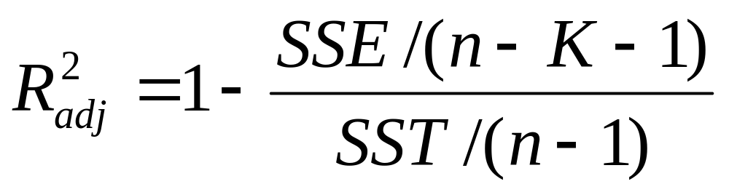
Computation
The "adjustment" is for the number of variables in the model.
Although regular R² may decrease when you remove a variable, the adjusted version may actually increase if that variable did not have much significance.
Multiple Regression I
Copyright © 2005 Brooks/Cole, a division of Thomson Learning, Inc.

Slide 31
4.3.2 The F Statistic
Since R² is so high, you would certainly think that the model contains significant predictive power.
In other problems it is perhaps not so obvious. For example, would an R² of 20% show any prediction ability at all?
We can test for the predictive power of the entire model using the F statistic.
Multiple Regression I
Copyright © 2005 Brooks/Cole, a division of Thomson Learning, Inc.

Slide 32
F Tests
Generally these compare two sources of variation
F = V1/V2 and has two df parameters
Here V1 = SSR/K has K df
And V2 = SSE/(n-K-1) has n-k-1 df
Multiple Regression I
Copyright © 2005 Brooks/Cole, a division of Thomson Learning, Inc.

Slide 33
F Tables
Usually will see several pages of these; one or two pages at each specific level of significance (.10, .05, .01).
Numerator d.f.
denom.
d.f.
Value of F at a
specific significance level
Multiple Regression I
Copyright © 2005 Brooks/Cole, a division of Thomson Learning, Inc.

Slide 34
F Test Hypotheses
H₀: β₁ = β₂ = …= β_{K} = 0 (None of the Xs
help explain Y)
H_{a}: Not all βs are 0 (At least one X is useful)
H₀: R² = 0 is an equivalent hypothesis
Multiple Regression I
Copyright © 2005 Brooks/Cole, a division of Thomson Learning, Inc.

Slide 35
F test for our example
S = 90.75 R-Sq = 85.5% R-Sq(adj) = 84.2%
Analysis of Variance
Source DF SS MS F P
Regression 2 1067797 533899 64.83 0.000
Residual Error 22 181176 8235
Total 24 1248974
F = 533899 / 8235 = 64.83 has p-value = 0.000
From tables, F_{2,22,.05} = 3.44 and F_{2,22,.01} = 5.72
Confirms that R² = 85.5% is not near zero
Multiple Regression I
Copyright © 2005 Brooks/Cole, a division of Thomson Learning, Inc.

